Slide 1


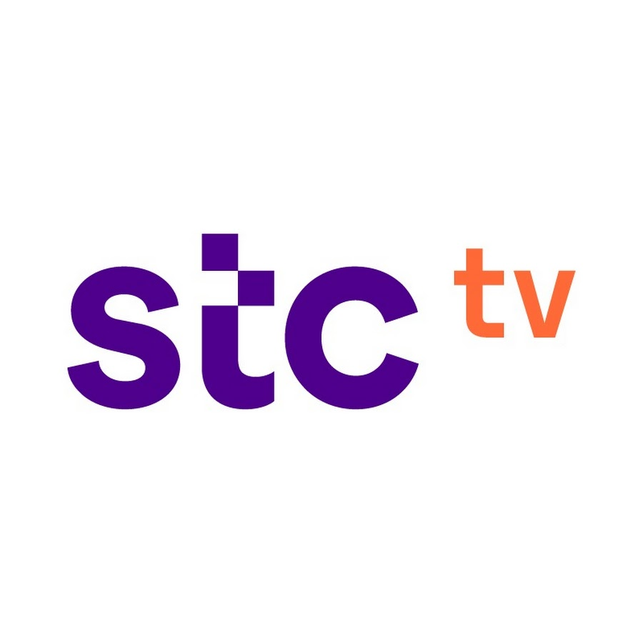


Stc tv customer behavior
Wajd alsulaiman
24/9/2024

Slide 2
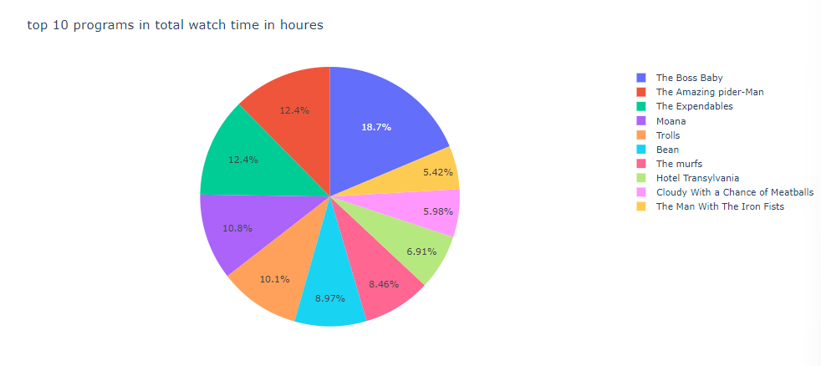



Chart The top 10 program
"Boss Baby" leads with 18.7% of total viewers, highlighting its strong popularity. In contrast, the second program has 12.4%, showing a notable 6.3% drop in viewer engagement compared to "Boss Baby."

Slide 3
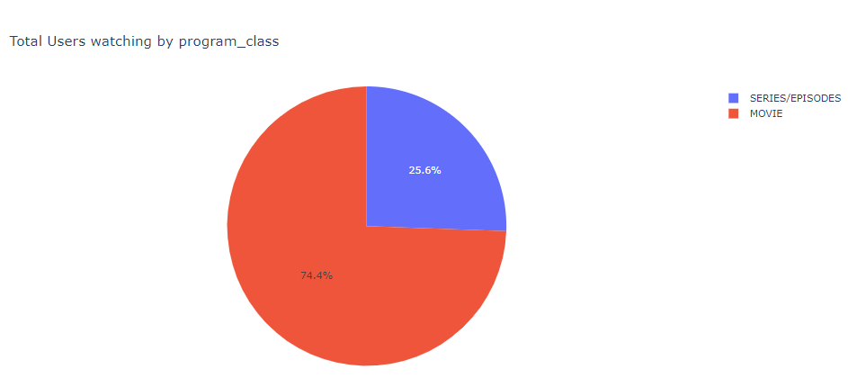
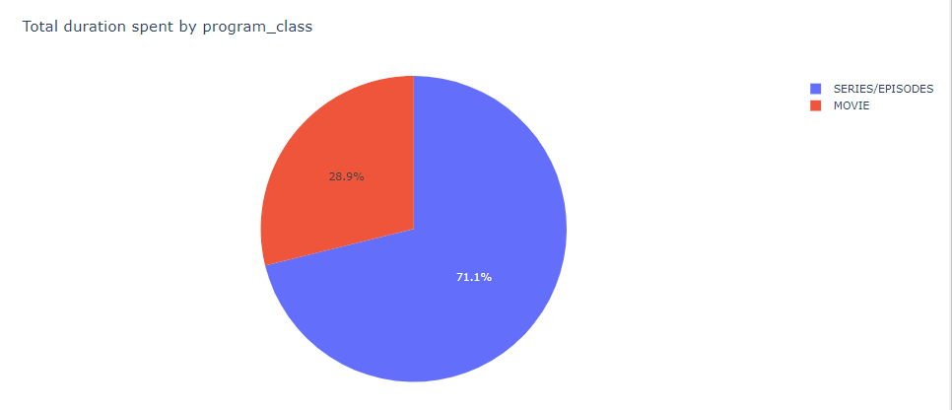

Chart duration of program class
Audiences spend 71.1% of their viewing time on series, while movies only account for 28.9%. This highlights a strong preference for series over movies.

Slide 4
Chart users watching by program
Viewers are highly engaged with movies, which account for 74.4% of total viewing time. This strong preference highlights that films remain a dominant form of entertainment, even with the rise of other formats.

Slide 5
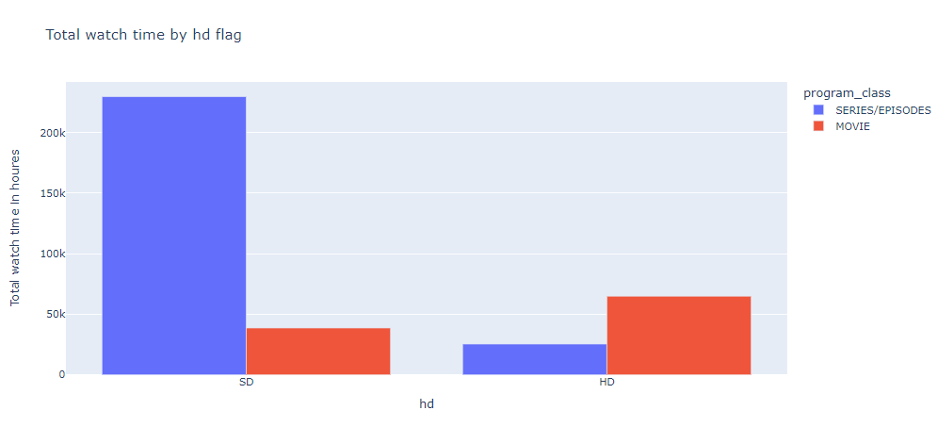
Chart time watch by hd and user watch by hd
Data shows viewers spend more time watching series in standard definition (SD), reflecting a trend toward binge-watching. In contrast, audiences prefer high definition (HD) for movies, indicating a stronger value placed on the cinematic experience. The same pattern is observed in user preferences.

Slide 6


Regression model the relationship between total watch time and date
Our analysis of total watch time against date for STC TV shows a highly accurate regression model, with a mean squared error of \(6.46 \times 10^{-27}\) and an R² score of 1.0, indicating a perfect fit. This highlights consistent viewer engagement patterns over time. Seasonal trends and external factors significantly influence watch time, enabling STC TV to optimize scheduling and content strategies effectively.

Slide 7
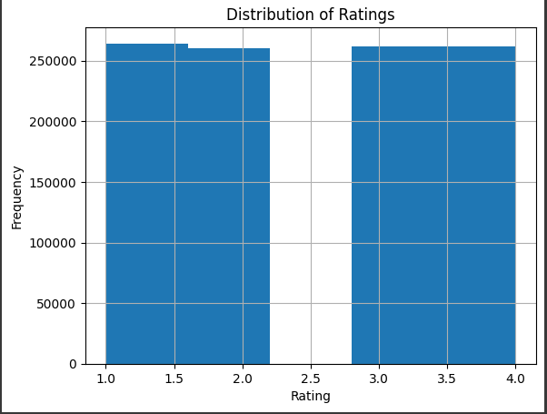
Rating distribution
The histogram shows a bimodal distribution of ratings for STC TV content, with two distinct peaks around 2.0 and 3.0. This suggests that users tend to have strong opinions about the content, either liking or disliking it intensely. Most ratings fall within the lower range (1.0-2.0 and 3.0-4.0), with fewer ratings in the mid-range (2.5-2.75). This could indicate a lack of content that appeals to a broader audience.

Slide 8

Recommender system Programs that users interested in
Our evaluation of the SVD recommendation system for STC TV shows an RMSE of 0.9118, meaning our predictions are less than one rating point away from actual viewer ratings. This strong accuracy supports our ability to deliver personalized content that aligns with user preferences. By leveraging these insights, we can create targeted strategies to enhance audience engagement and drive long-term viewer loyalty.

Slide 9
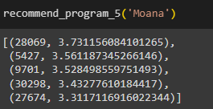
Recommender system MOANA HIGHEST 5 RECOMMENDATION
In our analysis of the recommendation system for "Moana," we identified five users with the highest predicted ratings, with User 28069 leading at 3.73. This targeted approach allows us to effectively market the program to those most likely to enjoy it, enhancing engagement and satisfaction. By personalizing recommendations, we strengthen our connection with viewers, boost retention, and create opportunities for upselling related content, ultimately driving growth and loyalty for STC TV.

Slide 10



Thank you

